Slide 1
SQL SELECT

Slide 2
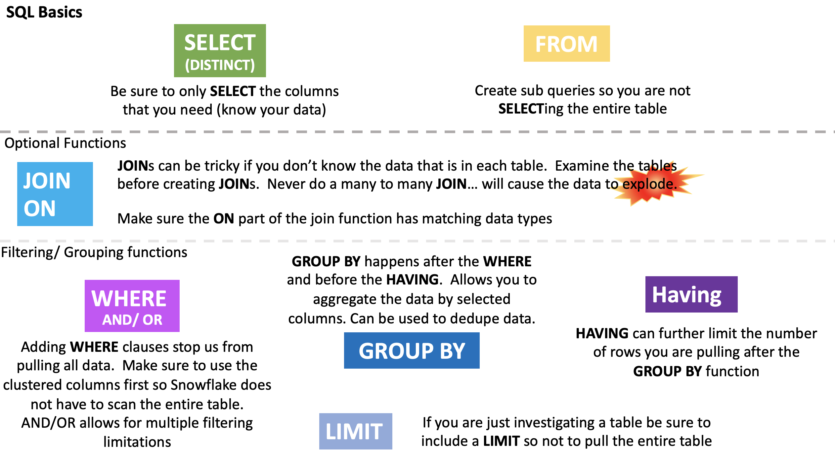
Snowflake Automation
Dynamic query optimization:
Ensures that Snowflake operates as efficiently as possible by looking at the state of the system when a query is dispatched for execution,
Looks at it multiple times – not just when it is compiled
USE THE SQL THAT YOU ALREADY KNOW
Rather than dealing with NOSQL and the like you can use SQL that your team is already familiar with to create dynamic, powerful, fast moving queries.

Slide 4
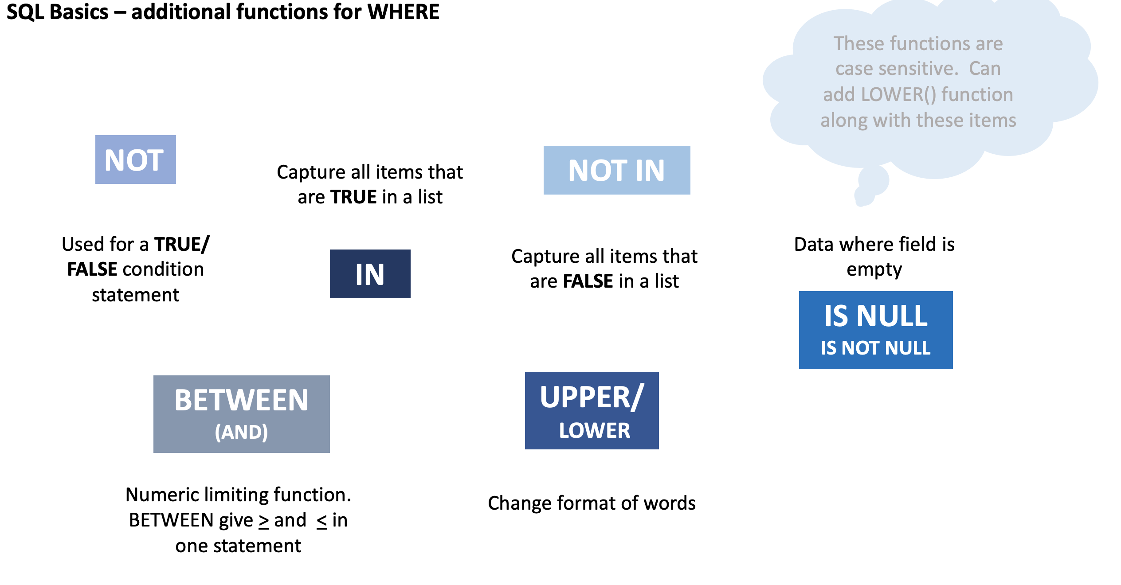

Slide 5
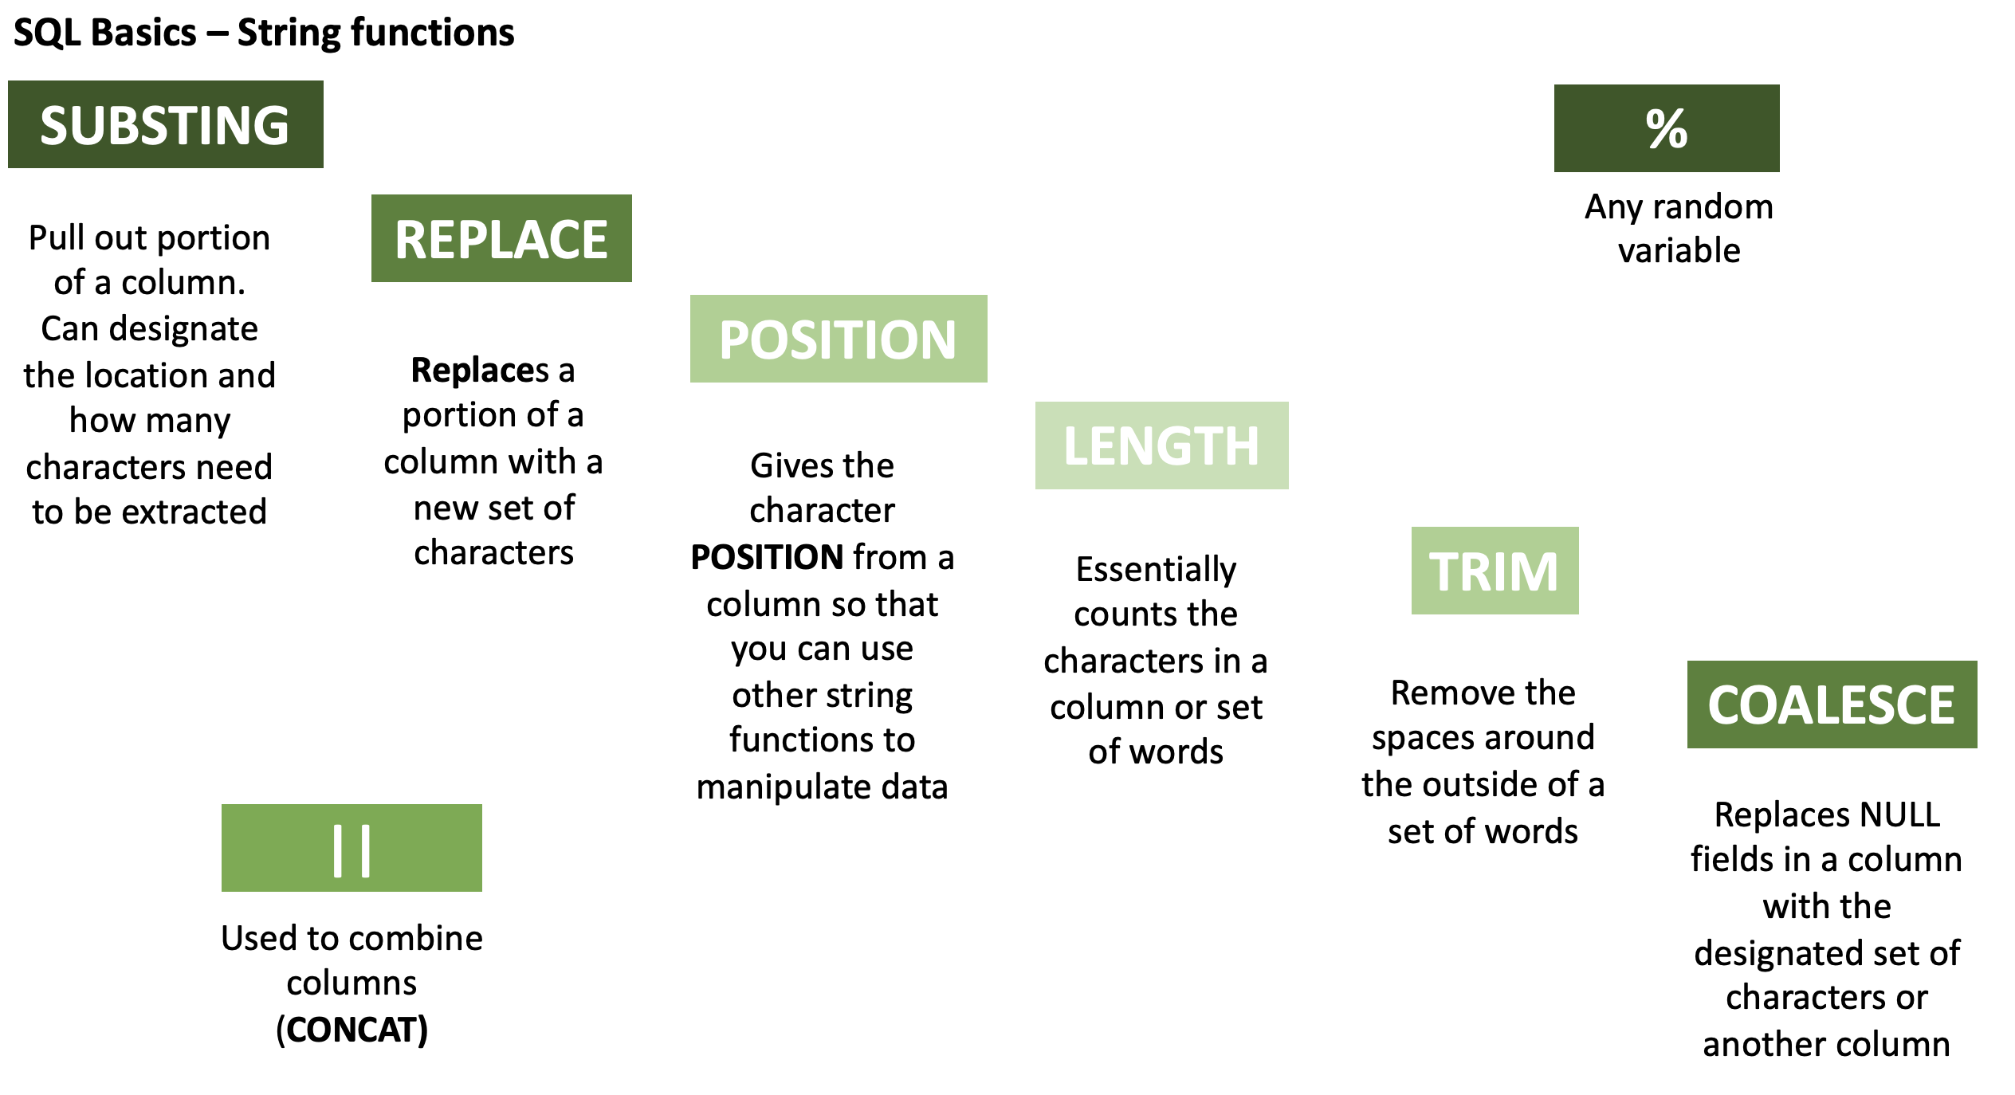

Slide 6
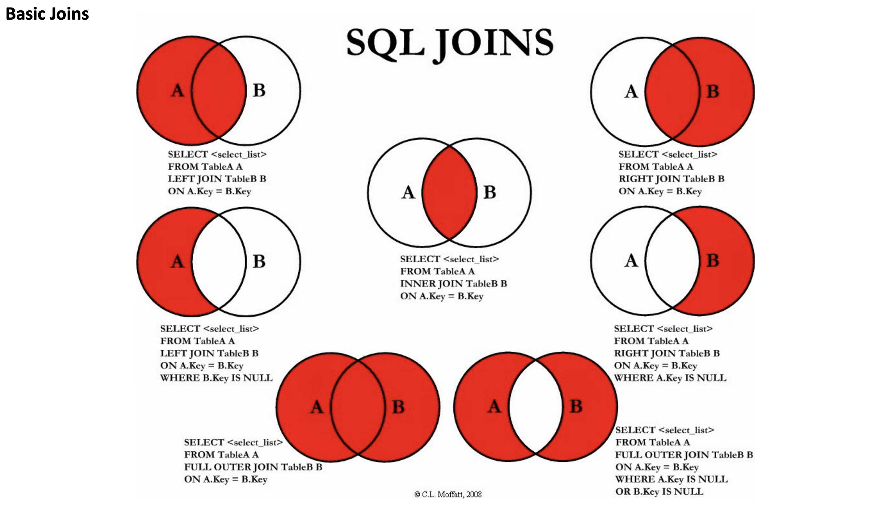

Slide 7


Hierarchy of SQL Functions
Mini Lab Breakout SELECT Statement Execution Order
SELECT DISTINCT <TOP_specification> <select_list>
FROM
(SELECT <select_list>
FROM <left_table> <join_type>
JOIN <right_table>
ON <join_condition> ) X
WHERE <where_condition>
GROUP BY <group_by_list>
HAVING <having_condition>
ORDER BY <order_by_list>
Notes:
FROM clause
ON clause
OUTER clause
WHERE clause
GROUP BY clause
HAVING clause
SELECT clause
DISTINCT clause
ORDER BY clause
TOP clause
Tips & Cautions
Aliases created in the SELECT list cannot be used by earlier steps.
This restriction is imposed because the column value may not yet have been determined when the clauses that appear before the SELECT clause are evaluated (such as the WHERE clause).
In some databases (such as MySQL), using aliases created in the SELECT list is allowed in GROUP BY and HAVING clause,
even though these clauses appear before (and are evaluated earlier than) the SELECT clause.
Expression aliases cannot be used by other expressions within the same SELECT list.
This is because the logical order in which the expressions are evaluated does not matter and is not guaranteed.
For example, this SELECT clause might not work as expected, and is therefore, not supported: SELECT a + 1 AS x, x + 1 AS y
When using an INNER JOIN, it doesn’t matter if you specify your logical expressions in the WHERE clause or the ON clause.
This is true because there's no logical difference between the ON and WHERE (except for when using an OUTER JOIN or GROUP BY ALL option).
The DISTINCT clause is redundant when GROUP BY is used.
Therefore, it would not remove any rows from the recordset.

Slide 8


Subqueries
Correlated vs Uncorrelated
Correlated refers to one or more columns from outside of the subquery
Uncorrelated has no such external column references. It is an independent query
Scalar vs Non-Scalar
Scalar subquery returns a single value (one column of one row)
Non-Scalar subquery returns 0 to multiple rows, each of which may contain 1 to multiple columns
SELECT p.name, p.annual_wage, p.country
FROM pay as p WHERE p.annual_wage <
(SELECT max(per_capita_gdp) FROM international_gdp i WHERE p.country = i.name);
SELECT c1, c2 FROM table1
WHERE c1 =
(SELECT max(x) FROM table2);
SELECT p.name, p.annual_wage, p.country FROM pay as p WHERE p.annual_wage < (SELECT per_capita_gdp FROM international_gdp WHERE name = 'Brazil');
Notes:
-- Uncorrelated subquery: select c1, c2 from table1 where c1 = (select max(x) from table2); -- Correlated subquery: select c1, c2 from table1 where c1 = (select x from table2 where y = table1.c2);
uncorrelated subquery in a where clause. The subquery gets the per capita GDP of Brazil, and the outer query selects all the jobs (in any country) that pay less than the per-capita GDP of Brazil.
The subquery is uncorrelated because the value that it returns does not depend upon any column of the outer query.
The subquery only needs to be called once during the entire execution of the outer query.
Uncorrelated - select p.name, p.annual_wage, p.country from pay as p where p.annual_wage < (select per_capita_gdp from international_gdp where name = 'Brazil’);
correlated subquery in a where clause. The query lists jobs where the annual pay of the job is less than the per-capita GDP in that country.
This subquery is correlated because it is called once for each row in the outer query and is passed a value, p.country (country name), from the row.
Correlated sub query - select p.name, p.annual_wage, p.country from pay as p where p.annual_wage < (select max(per_capita_gdp) from international_gdp i where p.country = i.name);

Slide 9
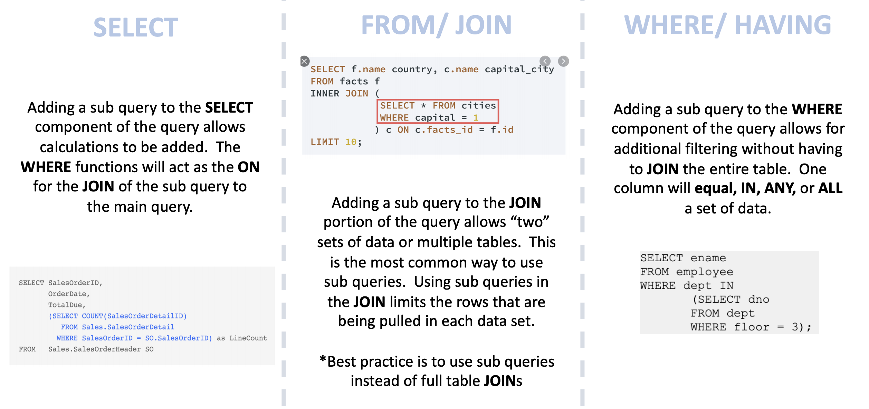
Subqueries – Where can they be used
Notes:
Where can you put subqueries ( use slide I created for SQL class)
Subquery operators operate on nested query expressions. They can be used to compute values that are:
Returned in a SELECT list.
Grouped in a GROUP BY clause.
Compared with other expressions in the WHERE or HAVING clause
Limitations
Although subqueries can contain a wide range of SELECT statements, they have the following limitations:
Some clauses are not allowed inside of ANY/ALL/NOT EXISTS subqueries.
The only type of subquery that allows a LIMIT / FETCH clause is an uncorrelated scalar subquery. Also, because an uncorrelated scalar subquery returns only 1 row, the LIMIT clause has little or no practical value inside a subquery.

Slide 10

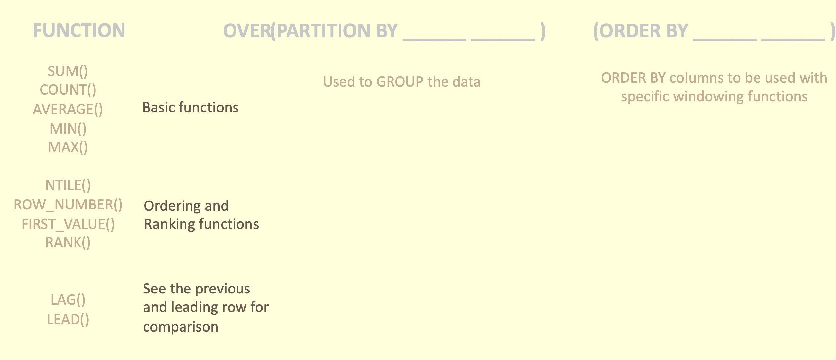

Windowing functions
Window functions operate on groups of rows that are related (e.g. by date or location). Snowflake supports:
General window functions.
Window functions that calculate rank (e.g. highest, second-highest, etc.)
Window functions that support cumulative window frames and sliding window frames
... OVER ( [ PARTITION BY <expr1> ] [ ORDER BY <expr2> [ { cumulativeFrame | slidingFrame } ] ] ) ...

Slide 11
More stuff on windowing functions

Slide 12
More Advanced querying
Querying semi structured data
Arrays allow data to be stored that is not used regularly
Arrays can be flattened if it needs to be accessed
Example of an array:
Using Sequences
Sequences are used to generate unique numbers across sessions and statements, including concurrent statements.
They can be used to generate values for a primary key or any column that requires a unique value
select vm.value:make::string as make, vm.value:model::string as model, ve.value::string as "Extras Purchased" from car_sales , lateral flatten(input => src:vehicle) vm , lateral flatten(input => vm.value:extras) ve;
"vehicle" : [ {"make": "Toyota", "model": "Camry", "year": "2017", "price": "23500", "extras":["ext warranty", "rust proofing", "fabric protection"]}
Notes:
Example of an array "vehicle" : [ {"make": "Toyota", "model": "Camry", "year": "2017", "price": "23500", "extras":["ext warranty", "rust proofing", "fabric protection"]}
Snowflake sequences currently utilize the following semantics:
All values generated by a sequence are globally unique as long as the sign of the sequence interval does not change. Concurrent queries never observe the same value, and values within a single query are always distinct.

Slide 13
REGEX

Slide 14
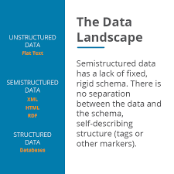
Snowflake Data Types
Snowflake offers native ingestion of various data types that other data warehouses don’t.
Have any of you ever been in a scenario where you needed to load, say, an XML or a multi-dimensional JSON into a structured SQL database?
How did you have to manipulate that data?
How much work did it take to get it in there?
Did you have to flatten it first?
The makers of snowflake felt your pain here and offer the VARIANT data type.

Slide 15
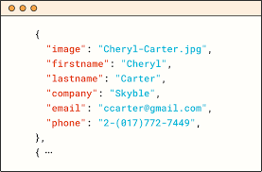
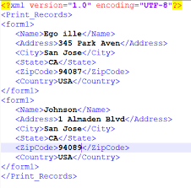
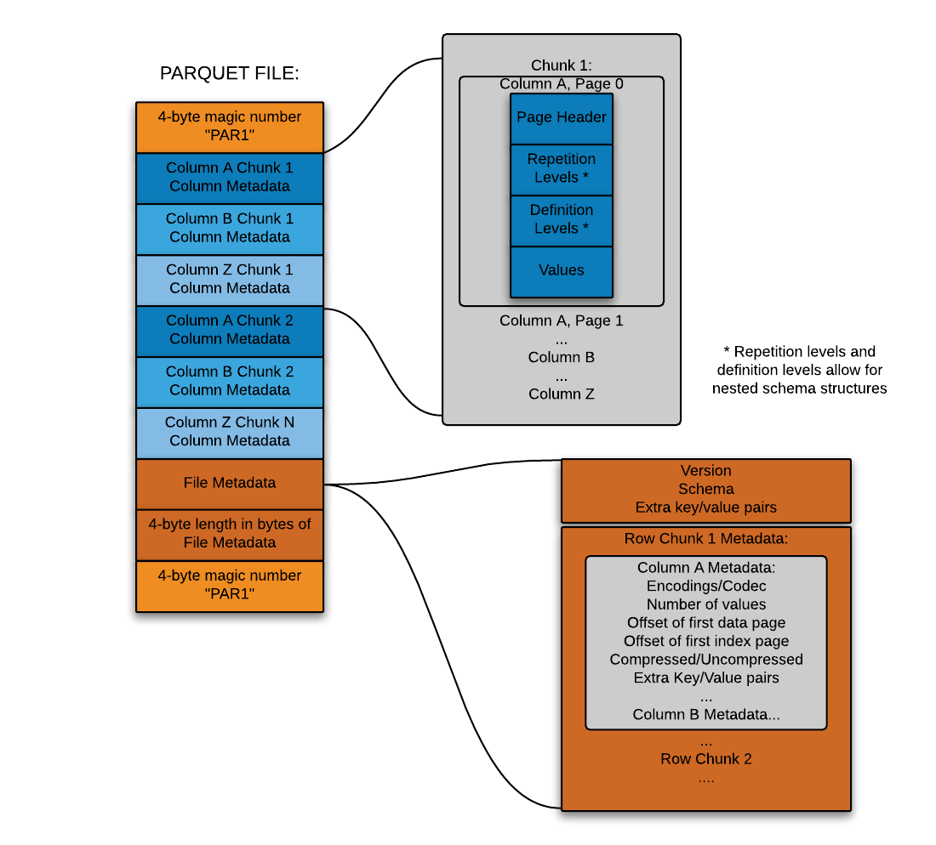
Snowflake data types
Snowflake started by making it possible to flexibly store semi-structured records inside a relational table in native form
This is accomplished through a custom datatype (Snowflake’s VARIANT datatype) that allows schema-less storage of hierarchical data, including JSON, Avro, XML and Parquet
This makes it possible to load semi-structured data directly into Snowflake without pre-processing, losing information, or defining a schema
You simply create a table containing a column with Snowflake’s VARIANT datatype and then load files containing semi-structured data into that table.
JSON
Avro
XML
Parquet

Slide 16
Flattening Arrays

Slide 17

Confused? ASK QUESTIONS

Slide 18
Break & Lab4

